Slide 1
CCHE Learning Session: Financial Aid
Emily Burns, Karla Nash, and Joe Donlay
October 2, 2019

Slide 3
State Aid Appropriations History

Slide 4
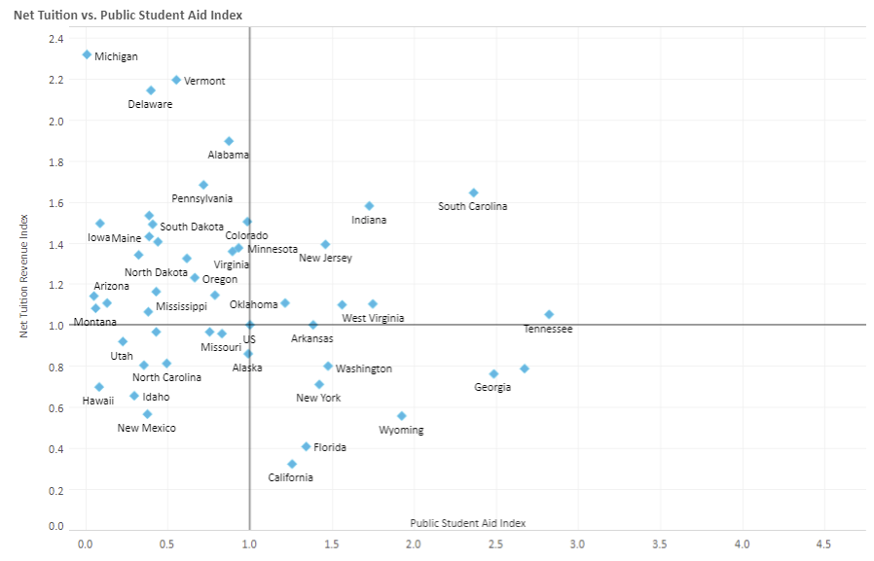
High aid, high tuition
Low aid, high tuition
Low aid, low tuition
High aid, low tuition
Source: SHEEO

Slide 6
Commission Authority CRS 23-3.3
Student Budget Parameters- Fall
Financial Aid Allocation Methodology- Spring
Statewide Policy- As needed
Colorado is a decentralized aid state. CCHE + DHE make allocations to institutions. Institutions package aid and make individual awards to students based on determined need and available resources.

Slide 7
$200 million
CCHE approves allocation of $200 million in state financial aid appropriations, annually
Need-based: $140 mil
Work-study: $23.4 mil
Categorical (entitlement): $18mil
Merit: $5 mil
CTE: $450k
Financial Aid Report available here

Slide 8
Current and Upcoming Issues
Financial Aid Statutory Revisions
Ongoing HB 19-1196 Implementation
Legislation affecting Financial Aid
Emergency Completion Grants
FY 2021 Financial Aid Allocations

Slide 9
Karla Nash
Colorado Community College System, Financial Aid Director

Slide 10
Joe Donlay
Colorado State University- Fort Collins, Financial Aid Director

Slide 11
CCHE Learning Session
February 7, 2020

