Slide 1
Enrollment Projection Model: Key Findings

Slide 2
How will demographic trends impact new student enrollment levels at Colorado’s public colleges and universities?

Slide 3
Some key facts about projected changes in the state’s population through 2020

Slide 4
Methodology

Slide 5
Methodology, continued

Slide 6
Methodology, continued

Slide 7
Methodology, continued

Slide 8
Two types of projections

Slide 9
RESULTS

Slide 10
Based on population change alone, Colorado’s public institutions could enroll more than 40,000 additional new Colorado students over Fall 2010 levels

Slide 11
Much of the growth will be fueled by growth of the state’s Hispanic / Latino population

Slide 12
Somewhat greater rates of growth at the state’s four-year institutions than at two-year institutions

Slide 13
Impact of the Front Range counties

Slide 14
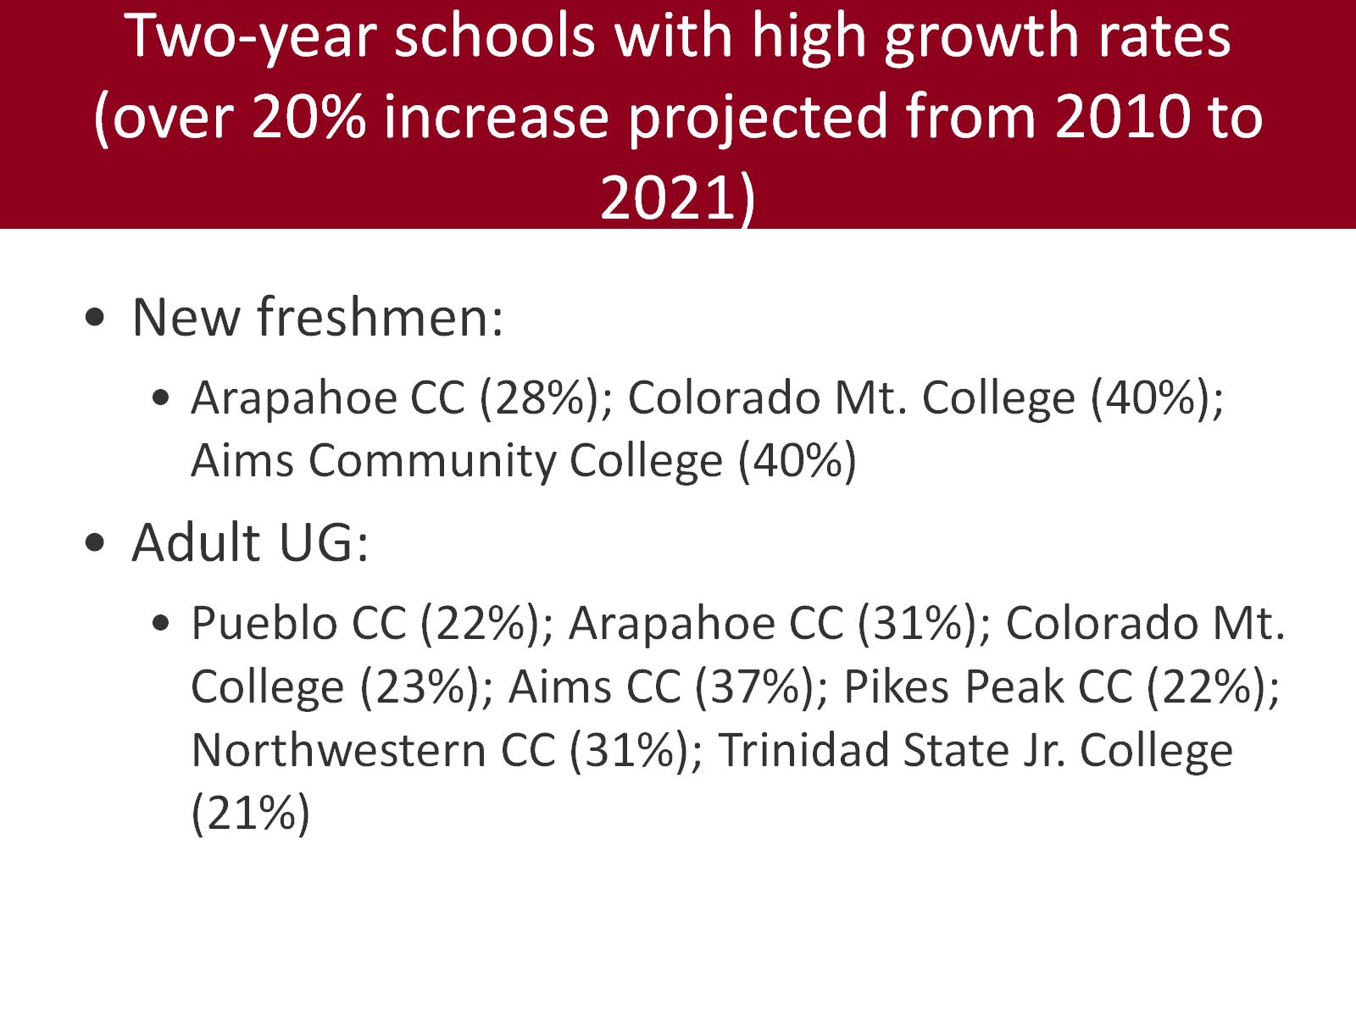
Two-year schools with high growth rates (over 20% increase projected from 2010 to 2021)

Slide 15
Four-year schools with high growth rates (over 20% increase projected from 2010 to 2021)

