Slide 1
Family-School-Community
Partnerships:
Four Essential Elements
Darcy Hutchins, Ph.D.
Director—Office of Family, School, and Community Partnerships
hutchins_d@cde.state.co.us

Slide 2
Response in the chat…
Name
Position (what and where)
What do you hope to gain from this session?

Slide 3
Session Outcomes
Understand how the Colorado Department of Education supports Family, School, and Community Partnerships (FSCP).
Learn about available resources from the Colorado Department of Education for inservice and preservice teachers.
Take a close look at the new FSCP Framework and User’s Guide.

Slide 4
Family-School-Community Partnerships at the Colorado Department of Education

Slide 5
Evolution of Family-School-Community Partnerships in Colorado
2009: Formation of the State Advisory Council for Parent Involvement in Education (Senate Bill 09-90)
2013: Creation of the Family Partnership Director Position (SB 13-193)
2019: Creation of the Office of Family-School-Community Partnerships and reauthorization of SACPIE.
2018-2020: Development of P-12 Framework.
2020-2021: Preservice Consortium Participation.
Notes:
This framework was an 18-month process for district staff, co-developed by district staff.

Slide 6
Systemic Support Structure
Federal and State Legislation
Colorado Department of Education
Districts
Schools
Students and Families
ESSA Section 1116
SB 09-90
SB 13-193
Family Partnership Director
SACPIE
CDE FSCP CoP
Other Advisory Groups
FSCP Coffee Chats
Directors and Coordinators
District Accountability Committees
Title I FSCP Liaisons
School Accountability Committees
High Impact Strategies
National Standards for FSCP
Achievement and Climate
Notes:
Darcy

Slide 7
What are Family-School-Community Partnerships?
Research-Based
Linked to Learning
Intentional
Proactive vs.
Reactive
Integrate and
Elevate
Sustainable
Realistically
Optimistic
Committed
Inclusive
Measurable
Beyond Random Acts
Context vs Content Expertise
Notes:
How do these concepts help DACs to boost the family voice? Help schools and the district with FSCP as a content area?

Slide 8
School-Level Partnership Structures
Implementing the National Standards for Family-School Partnerships
Welcoming All Families into the School Community
Communicating Effectively
Supporting Student Success
Speaking Up for Every Child
Sharing Power
Collaborating with the Community
Sharing Leadership
Action Planning
Evaluating
Customized
Comprehensive
Continually Improved
Notes:
This slide represents the school-level research-base for comprehensive and sustainable partnerships. More information about the National Standards are in the handout “Goals and Indicators.”

Slide 9
Relative Impact of Family Partnership Strategies on Student Learning
Lower impact
Higher impact
Celebrations
Parent help on administrative tasks
Parent training events
Goal-setting talks
Weekly data-sharing folders
Parent resource rooms
Regular, personalized communication
Fundraisers
Back to school night
Home visits
Family support services
Parent-teacher conferences
Positive phone calls home
Modeling of learning support strategies
Potlucks
Performances and showcases
Generic school newsletters
Interactive homework
Classroom observations
Parent help on learning projects
Flamboyan Foundation defines family engagement as collaboration between families and educators that accelerates student learning.
Notes:
Flamboyan Foundation, in Washington DC, summarized the latest FSCP research in the following slide. It shows the impact of different activities on student learning. Do not misinterpret this slide and think that low impact is bad and high impact is good. The lower impact activities are still good things to do. This slide just indicates what has the most direct impact on student learning, and therefore, where you should ultimately focus your resources.

Slide 10
P-12 Framework and User’s Guide

Slide 11
Stakeholder Feedback and Consultation
Process and Timeline
June 2018—first meeting with other State Education Agencies
January 2019—definition finalized after internal and external feedback
April 2019—statewide community conversations with families
April 2019—focus groups with district-level FSCP leaders
June 2019—Colorado Department of Education staff feedback
August 2019—Local Education Agency and other organization consultation
November 2019—statewide survey, close-ended questions
December 2019—completion
January 2020 and beyond—implementation!
**The State Advisory Council for Parent Involvement in Education is an active participant in drafting the Framework.
Notes:
This framework was an 18-month process for district staff, co-developed by district staff.

Slide 12
Purpose
Purpose
Develop systemic and sustainable state- and district-level structures that proactively integrate and elevate FSCP that link to positive student outcomes and an inviting school culture.

Slide 13
CO FSCP Framework for Districts and Schools
Definition
Families, early childhood programs, schools, and communities actively partnering to develop, implement, and evaluate effective and equitable practices to improve educational outcomes for children and youth.

Slide 14
Four Essential Elements
Create an Inclusive Culture
An inclusive culture honors the lived experience of families in early childhood programs and/or the school community.
Build Trusting Relationships
Trusting relationships enable families and programs/schools to partner about the education outcomes for children and youth.
Design Capacity-Building Opportunities
Capacity building opportunities for staff and families promote shared leadership about educational outcomes for children and youth.
Dedicate Necessary Resources
Necessary resources integrate and elevate partnering practices to scale.

Slide 15
Dimensions of Excelling Programs
Excelling Programs
Principal Leadership
Attending to Inequities
Giving Voice/ Sharing Power
Programmatic Approach
Teamwork/ Shared Leadership
Evaluation
Notes:
We drew upon these 6 components to help imagine what it is excelling partnership programs do.

Slide 16
Using the Rubric
Step 1
Individuals rate the site’s partnership efforts
Step 2
Stakeholders discuss the ratings with one another
Step 3
The group establishes improvement goals and next steps to help meet those goals.
Notes:
Step 1: Individuals establish their own rating of the site’s partnership efforts
Use these prompts to provide details and descriptions of your site or school.
Compare your responses to the rubric and identify which rating most closely matches your description.
Record the rating in the Summary Worksheet provide in this this user’s guide.
Step 2: Bring together a group of stakeholders to participate in a discussion about their ratings.
This process should include a range of stakeholders including administrators, teachers, family members, and community partners.
As a group, members of the evaluation and accountability committee should share their ratings with one another, as well as the reasons why they felt that rating was most appropriate.
We encourage this group to come to a consensus about how the site is performing across each of the four Essential Elements. If one or two individuals have a rating that is very different from others, it is important to let those people speak openly and honestly about why they rated the site that way. Listen to their reasoning with empathy and do not try to shut down conversation. This conversation is not meant to change people’s minds, it is about hearing a diverse range of perspectives.
Step 3: The evaluation group should agree to partnership improvement goals and a set of next steps to help the site meet those goals.

Slide 17
Rating System

Slide 18
Sample Rubric

Slide 19
Calculate Scores

Slide 20
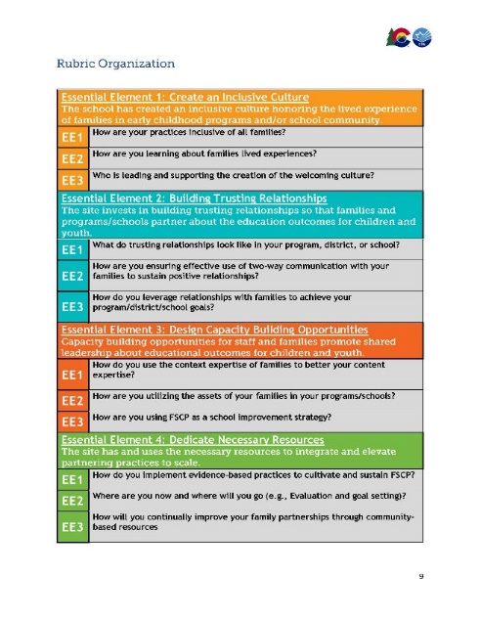
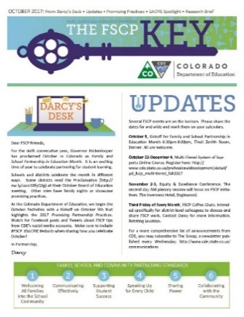
Available Colorado Resources

